Slide 1
Chatbots Development with Deep Learning
General Deep Learning Architecture for Chatbots
Hands on: Chatbot Development with Deep Learning
Shahzaib Hamid
AI Sciences Instructor

Slide 2
Module Overview
Architecture
Hands on: Deep learning Chatbot Development using LSTM
General Architecture
Decoder-Encoder Model
Initialization
Training
Testing

Slide 3
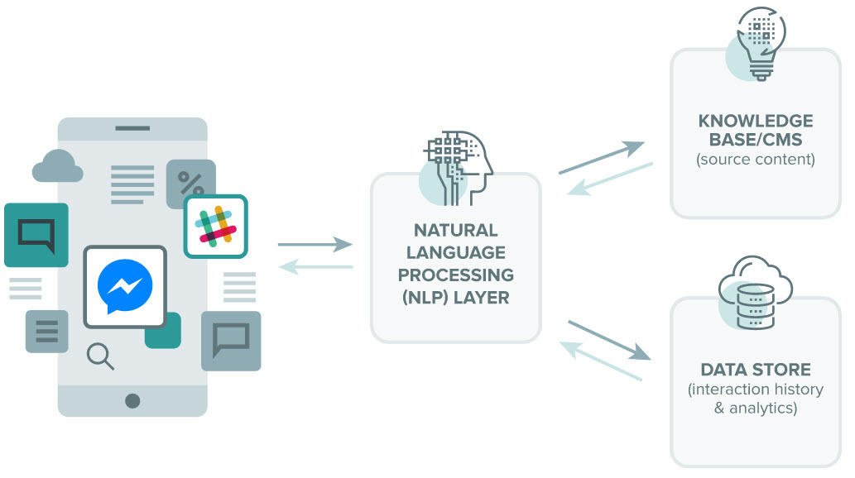
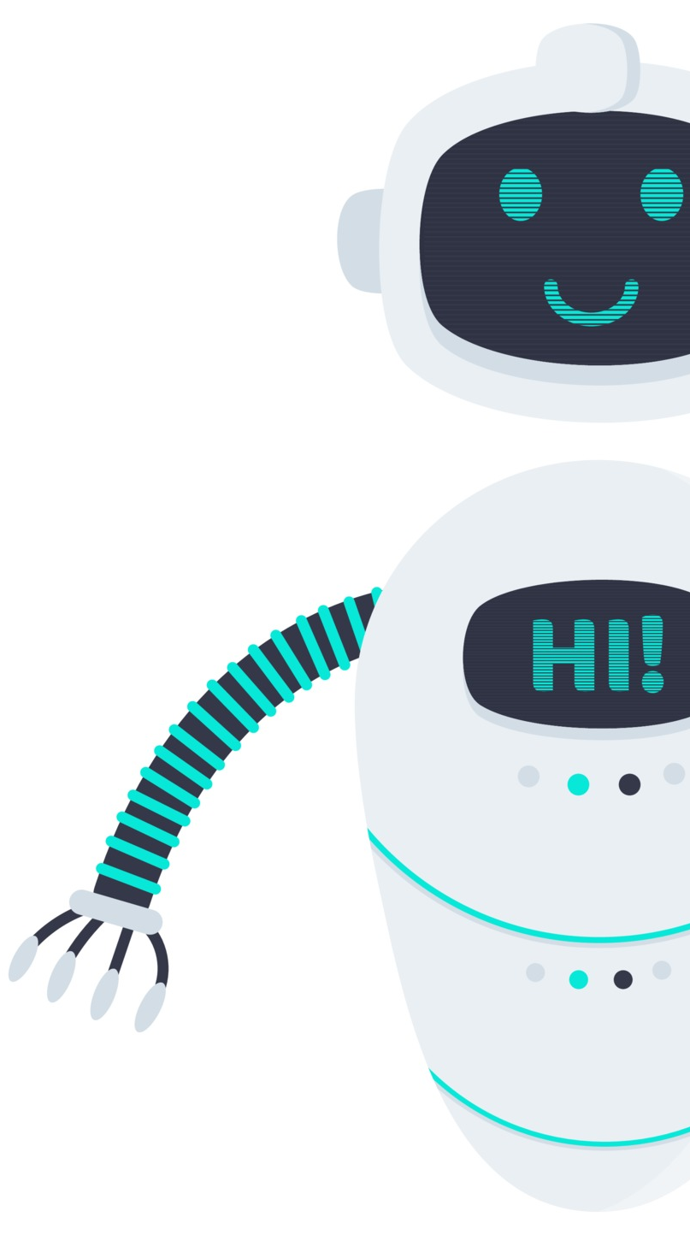

Architecture
General Architecture
Deep Learning Integration

Slide 4
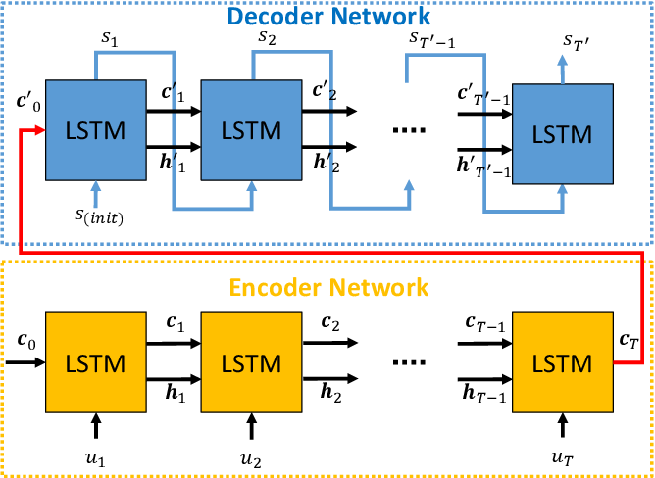
Architecture
Decoder – Encoder Model

Slide 5
Chatbot Development with Deep Learning
Steps Involved in Deep Learning Development
Packages Installation
Defining Chat Model
Tokenization
Setting-up Encoder-Decoder
Implementing RNN based Model Development
Training, Testing and Validating Chatbot

